Slide 1

Access to Finance and the Role of Financial Creditworthiness for Water Utilities
Dr Jeremy Gorelick, Eyal Shevel
June 2020

Slide 2
Agenda
Introducing creditworthiness
The importance of financial creditworthiness for water utilities
Assessing financial creditworthiness
Financial instruments and their dependence on creditworthiness
Common creditworthiness mistakes/challenges and how to overcome them
Fundamental steps to improve creditworthiness including who is involved and expected time commitment required
Discussion

Slide 3
Basic Terms
Capital Markets:
  Financial markets in which long-term debt (over a year) or equity-backed securities are bought and sold. Capital markets channel the wealth of savers to those who can put it to long-term productive use, such as companies or governments making long-term investments.
Commercial Finance:
  Loans that are extended at market rates.
Concessionary Finance:
  Loans that are extended on terms substantially more generous than market loans. The concessionality is achieved either through interest rates below those available on the market or by grace periods, or a combination of these. Concessional loans typically have long grace periods.
From :OECD Glossary, https://stats.oecd.org/glossary/

Slide 4
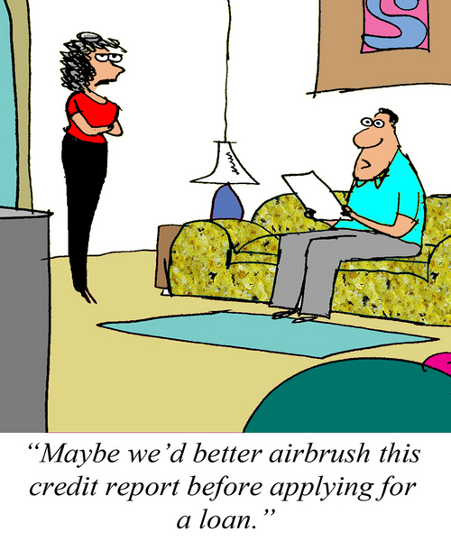
Introducing Creditworthiness

Slide 5
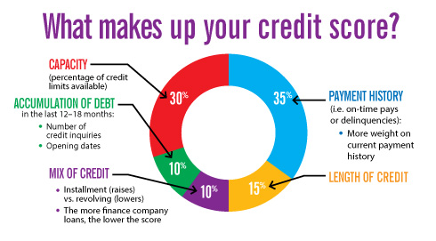
Credit Scores
From : Dupaco Credit Union, https://www3.dupaco.com/dupaco/images/interior/credit-score-chart.jpg

Slide 6
What is creditworthiness?
Creditworthiness is a measure of ability to meet debt obligations. It considers:
Financial management incl. current debt obligations and historical debt servicing
Own source revenues and ability to generate positive cash flows
Governance and operational performance
Regulation and its impact on growth and profitability
S&P, Moody’s, Fitch, and GCR credit ratings are indicative measures of creditworthiness used by financing institutions
Investment grade ratings from AAA (Aaa) to BBB- (Baa3)
Lower quality / junk ratings from BB+ (Ba1) to D (C)
High creditworthiness increases the ability & lowers the cost to water utilities of accessing external financing

Slide 7
How is creditworthiness measured?
Moody’s | Standard & Poor’s
Aaa | AAA
Aa | AA
A | A
Baa | BBB
Ba | BB
B | B
Caa | CCC
Ca | CC/C
Investment
Speculative

Slide 8


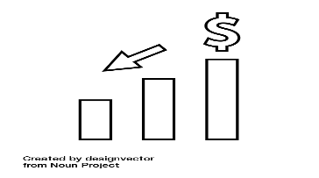
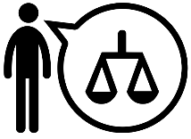
Why does creditworthiness matter?
Credit ratings boost water utilities’ financing prospects and help in decision-making
Access to capital markets: Getting a formal credit rating allows water utilities to get listed on capital markets. For example, the Kenya Pooled Water Fund, through bond issuances relying on the ratings of underlying water service providers, helps to attract new investors.
Trusted source of company information: The credit review, which is a key part of the credit rating process, provides an independent opinion on the water utility which boosts investors confidence in its performance. A credit rating, no matter how low, can be important to investors in their consideration of a utility.
Lowered cost of capital: Research has shown that higher credit ratings attract more favourable rates, normally shown through lower interest rates and longer terms, which is a factor of investor confidence in the companies seeking finance.
Streamlined operations: Regular review of water utilities to reassess their credit rating helps to improve accountability and efficiency of the utility’s operations
From: “Ratings of municipalities,” European Rating Agency, http://www.euroratings.co.uk/index.php?option=com_content&view=article&id=87:rating-municipalit&catid=42:typy-ratingov&Itemid=27&lang=en: “Why Credit Ratings Are Still Important,” https://seekingalpha.com/article/228415-why-credit-ratings-are-still-important-in-determining-stock-valuation.

Slide 9
How do creditworthiness and access to finance intersect?
Infrastructure development requires multi-year plans aligned to high-level strategy and annual budgets
Strategic
10 year plan
Tactical
3-year capital program (budget)
Operational
Annual programs
Water utilities set out a long-term vision and policies against which planning should be defined
Multi-year capital plans define each phase of implementation for longer term investments
Annual budgets incorporate the relevant activities and costs for a given year
From New Brunswick, Long term strategic capital planning framework: Investing in infrastructure renewal, (New Brunswick, 2016), http://www2.gnb.ca/content/dam/gnb/Departments/trans/pdf/en/Publications/LongTermStartegicCapitalPlanningFramework.pdf

Slide 10
How does creditworthiness impact the types of funding available?
Accessing Commercial Financing Entails Being Creditworthy. To Be Creditworthy Service Providers Must Achieve Reasonable Financial Sustainability
Fully Creditworthy
Financially Sustainable +
Country Conditions and
Developed Financial Markets
Commercial Finance
Financially Sustainable
Revenue + Other Reliable Resources
Covers Full Cost of Service Providing and
Sustaining Service
Donor / Public Credit Enhancement
Operating Cost Recovery
Profitable in Any Given Year
But Not Sustainable in Long-Term
Concessional Finance
Pay-As-You-Go
Recovery of Cash Outlays
Capital subsidies needed
Grants
Unviable Provider
Capital & Operational
Subsidies Needed
Adapted from World Bank Group, Global Water Practice

Slide 11
Credit-shy Utilities
Shadow ratings –
  An unofficial rating given to a bond or an issuing party by a credit agency but without any public announcement of the rating
  May be helpful to a company that is contemplating issuing rated debt in the market but is unsure about how it would be received
Shadow ratings allow negative issues to be addressed before being made public

Slide 12
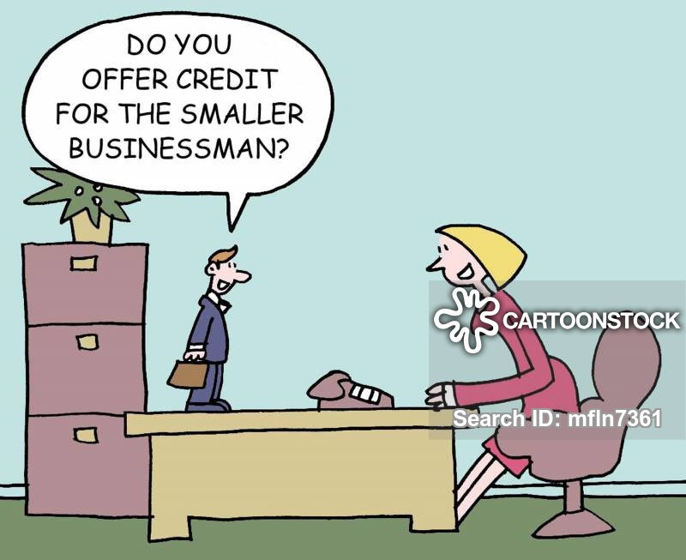
The importance of financial creditworthiness for water utilities

Slide 13
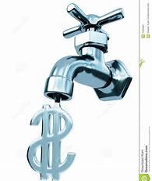
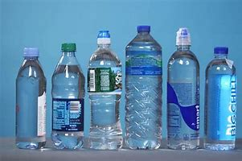
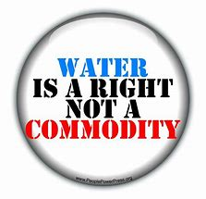

The uniqueness of the water sector
Water as a commodity
Water as a basic human right

Slide 14
Water utility creditworthiness in Africa
Name | Short-term rating | Long-term rating
Athi Water Service Board, Kenya | A2 | BBB+
Nairobi City Water and Sewerage Company, Kenya | A3 | BBB
National Water and Sewerage Corporation (NWSC), Uganda | A2 | A
Office National de l’Eau et l’Assainissement (ONEA), Burkina Faso | A2 | BBB+
Senegalaise des Eaux (SDE), Senegal | n.a. | n.a.
Societe Nationale des Eaux du Senegal (SONES), Senegal | A1 | A+
Societe Nationale d’Exploitation et de Distribution des Eaux (SONEDE), Tunisia | A1- | A
From African Water Utilities: Regional Comparative Utility Creditworthiness Assessment Report, December 2008, http://documents.worldbank.org/curated/en/419831468009295190/African-water-utilities-regional-comparative-utility-creditworthiness-assessment-report

Slide 15
Assessing financial creditworthiness

Slide 16
GCR Group Profile
History
Africa Focus & Leadership
Regulatory Recognition
Majority Shareholding
1996:Started as Duff & Phelps Africa
2001: Renamed as Global Credit Rating Company
2019: Rebranded as GCR Ratings
Largest African rating coverage
400+ ratings
In 20+ countries
Largest analytical presence in Africa
Regional offices in South Africa, Kenya and Nigeria
Registered Credit Rating Agency in:
South Africa (FSCA)
Nigeria (SEC)
Kenya (CMA)
Mauritius (CMA)
Approved External Credit Assessment Institution (ECAI) by the South African Reserve Bank
KfW/DEG, a Development Finance Institution
The Carlyle Group, a multinational private equity, alternative asset management and financial services corporation

Slide 17

GCR approach to water utility credit rating
Operating
environment
Structural
International scale
issuer rating
International
Scale ACE
Business
Profile
Instrument
International scale
issuer rating
GCR
Risk Score
Anchor Credit Evaluator
Rating Adjustment Factors
Financial
Profile
Structural
National scale
issuer rating
National
Scale ACE
Instrument
National scale
issuer rating
Comparative
Profile

Slide 18
GCR approach to water utility credit rating
Component
Factor
Sub-score
Country risk (0 to 15)
Operating environment
Sector risk (0 to 13)
Competitive position (-8 to +5)
Business profile
Management & governance (-5 to 0)
GCR Risk Score
Earnings profile (-5 to +3)
Financial profile
Leverage and cash flow (-5 to +5)
Liquidity (-10 to +2)
Peer comparison (-2 to +2)
Comparative profile
External support

Slide 19
Elements of credit ratings: Overview
GCR approach to rating Water utilities balances their unique mix of both private and public sector institution characteristics
On the one hand, WU’s are usually partially or wholly owned by the national government of a particular country, or fall under some regional jurisdiction.
The provision of services and the pricing thereof tends to be highly regulated.
On the other hand, WU’s tend to operate as corporatised legal entities, with a distinct Board of Directors and a management structure similar to that of private sector entities.
Strong Corporate Governance is critical to managing these sometimes competing priorities

Slide 20
Elements of credit ratings: Business profile
Score description | Earnings generation (typical descriptors)
Highest | Benefits from a monopoly or near monopoly position in the Water industry. Is domiciled in a well-developed market with substantial modern infrastructure. Has a very strong track record of efficient service delivery. Considered to demonstrate global best in class operations. Best in class technologies and intellectual property. Strong profit and cash generation.
High | Benefits from a monopoly or near monopoly position in the Water industry. Its corporate status and commercial position is underpinned and protected by legislation. Has a strong track record of efficient service delivery, notwithstanding that it may face significant backlogs and operation challenges within the jurisdiction it operates. Is able to report cash profitability and cash generation in most years. Has well developed client and supplier relationships.
Intermediate | Operates in a regulated Water industry but faces meaningful competitions for business from other players. Reflects some advantages of incumbency, such as ownership of key infrastructure or long-standing client base, as well as an advantageous relationship with national government. Has adequate technologies and operating structures to meet its key service mandates, but technologies may lag those of more modern private sector companies. Earnings and cash flow performance may be variable.
Low | Typically applies to water utilities that operate in industries that ace substantial competition from other industry players. While the water utility may retain some advantages of incumbency and an advantages relationship with the national government, its is likely facing an erosion of it market position to new entrants. Earnings and cash flow likely reflect a deteriorating trend.
Lowest | . Small to very small industry player in a highly competitive water industry, with no clear competitive advantages. The lowest scores will typically be associated with long term weak earnings and /or failed or close to failing.

Slide 21
Elements of credit ratings: Earnings performance
Score description | Competitive position (typical descriptors)
Highest | High EBITDA margins and /or consistent cash flows, comparing better than peers operating in the same or similar markets. Proven earnings stability through the cycle. Demonstrated strong working relationship with regulatory bodies and limited pricing control. Flexible cost structure with strong ability to manage costs through the cycle. No material backlogs or social responsibility liabilities.
Intermediate | Track record of delivering on core service mandate while covering or exceeding operating costs, maintenance expenditure and some capital investment requirements. Tariff structure that allows for full or majority cost recovery and sufficient flexibility to adjust for unforeseen external shocks. Adequate flexibility in cost structure with some ability to manage costs through the cycle. For SOE’s that perform critical social services, or provide economic infrastructure, government grants to mitigate small operating losses are forthcoming.
Low | Earning’s are not sufficient to cover operating costs on a consistent basis, although the this may be fully or partially compensated by grant income. Tariff structure is inflexible or there are other demonstrated weaknesses in the payment model. Little flexibility in the cost structure, with variable margins through the cycle. Negative scores may be tempered for entities where a profit motive is not considered primary,
Lowest | Persistent large operating losses, and strong concerns as to the sustainability of financial support.

Slide 22
Elements of credit ratings: Leverage and Capital
Ratio analysis – WU’s are associated with low cyclicality and inelastic demand
Adjustment Factors
Leverage ratios | Net Debt/EBITDA (x) | OCF to Gross Debt (%) | EBITDA / Interest (x)
Strong (low gearing) | 2.5x | 2.5x | >13x
Intermediate | 2.5x – 4x | 2.5x – 4x | 4x – 13x
Weak | 4x – 6x | 4x – 6x | 1.5x – 4x
Very Weak | >6x | >6x | <1.5x
Negative adjustments
Currency risk
Funding concentration
Short term concentration
Debt growing quickly
Weak municipal entities
Positive adjustments
Wide access to funding from different banks
Access to capital markets
Alternative funders such as life assurance
Well spaced maturity profile

Slide 23
Elements of credit ratings: Liquidity and Support
Liquidity - Uses vs Sources
  Sources - Projected income + unrestricted cash + committed funding lines + grants or other funding commitments
    Less
  Uses – Debt service costs + capital commitments + exceptional outflows
Government support - Can get uplift to the support floor – equivalent to the country and sector risk score
Explicit includes guarantees, offtake agreements or other written commitments
Implicit support – need to assess the likelihood which is a factor the importance of the LRG to Government objectives

Slide 24
GCR Rating Process
Public and Private ratings process typically takes 6-8 weeks
Publication
Rating request from Issuer
Public or Private rating
Assign Lead Analysts
Analysis of operating environment, public and non-public information
In depth analysis based on established & publicly available GCR criteria
Rating panel committee
Assigning of rating
Rating outcome communicated to issuer
Draft credit rating announcement and private rating letter/report sent to issuer to check for factual accuracy and presence of non-public information
Public rating: final credit rating announcement publicly released to market
Private rating: final confidential rating letter/rating report sent to issuer no public release
Detailed questionnaire and agenda sent ahead of meeting.
Meeting / On site visit with Management and other stakeholders
Issuer Notification
Analysis
Issuer Meeting
Initial Evaluation
Engagement
Ongoing monitoring/surveillance

Slide 25
GCR Rating products
 | Public Rating | Private Rating | Rating Estimate Service | Credit Assessment
Description | Ratings that are publicly disclosed usually done on a solicited basis | Ratings that are provided directly to a rated entity, its agents or on a third party request and are confidential | Analytical tool for rated or unrated entities that provides entity with indicative ratings for a number of hypothetical scenarios Can only be obtained once every 6 months. Not a GCR rating | Limited and typically confidential assessment of relative credit worthiness which may support a credit rating or a financing structure. Typically requested by a third-party Not a GCR rating
Distribution | Disclosed publicly, Published on GCR’s website | Not disclosed publicly, only to rated entity, its agents or a third party on request | Not disclosed publicly | Typically confidential
Surveillance | Yes – ongoing monitoring | Point in time or monitored | Point in time | Point in time or monitored
Rating Output | Credit rating announcement | Private rating letter / report | Confidential letter/ report | Confidential letter/report

Slide 26
Credit rating comparisons:
Kenyan Water Service Providers
 | WSP1 | WSP2 | WSP3 | WSP4 | WSP5
Financial metrics
Income (KES) | 762,6 | 627.0 | 641.0 | 417.8 | 253.3
EBITDA margin (%) | 36,5 | 17,7 | 7,3 | 29,7 | 22,1
Operating margin (%) | 24,2 | 16,8 | 3,8 | 17,7 | 3,5
Staff cost ratio (%) | 40.7 | 39.4 | 34.5 | 41.4 | 39.8
Net trade debtor : revenue (%) | 84,3 | 44,3 | 23,5 | 31,9 | 103,3
Total debt (KES) | 1 834,6 | 0,0 | 3,2 | 762,6 | 0,0
Cash (KES) | 133,8 | 18,2 | 5,9 | 134,8 | 3,2
Net debt: EBITDA (%) | 871,4 | n.a | 22,7 | 555,5 | 39,9
Net debt: Ave (%) | 940,0 | n.a | 43,4 | 665,9 | 50,3
Net interest cover (X) | 17,2 | n.a | 13,7 | - 5,6 | n.a
Net debt: Assets (%) | 89,0 | n.a | 9,0 | 76,2 | 8,6
Operating metrics
Water coverage (% of pop) | 74,0 | 97,0 | 66,0 | 93,0 | 87,0
Sewerage coverage (%of pop) | 0,0 | 0,0 | 18,0 | 25,0 | 20,0
NRW (%) | 43,0 | 31,0 | 41,0 | 18,0 | 38,0
AG outcome | Adverse | Qualified opinion | Qualified | Qualified opinion | Qualified opinion
Rating outcome | BBB(KE) / BBB-(KE) | A(KE) / BBB+(KE) | BBB+(KE) / BBB(KE) | A(KE) / A-(KE) | BBB(KE) / BBB-(KE)

Slide 27
Credit rating comparisons:
National Water and Sewerage Company Uganda
Operations
Connections rose by 40% between FY13 to FY18
Water production increase by 50%.
NRW decreased from 60% in 1998 to 31% at FY18, (further reduction are hampered by the aging infrastructure and faulty meters in Kampala)
Financial
Efficient and sustainable tariff structure – covers the rising unit production cost
positive margin between the average tariff charged and the costs per unit has ensured ongoing financial profitability
Det utilization limited so significant capital raising capacity
NWSC enjoys substantial access to grant funding from a wide range of development institutions and donors
Demonstrated strong ability to bring large capex projects to fruition

Slide 28
Credit rating comparisons: Typical challenges
Substantial investment needed which requires capacity at all levels
Old infrastructure impacts operating performance
Many investment decisions are being taken at the political level without necessary input from the Authority
Too many parties with conflicting advise creates policy paralysis
Vested interests impact all levels of service provisions
Legislation is often prohibitive of efficient capital restructuring
Key strengths in developing economies
Substantial debt raising capacity
Hungry capital markets

Slide 29
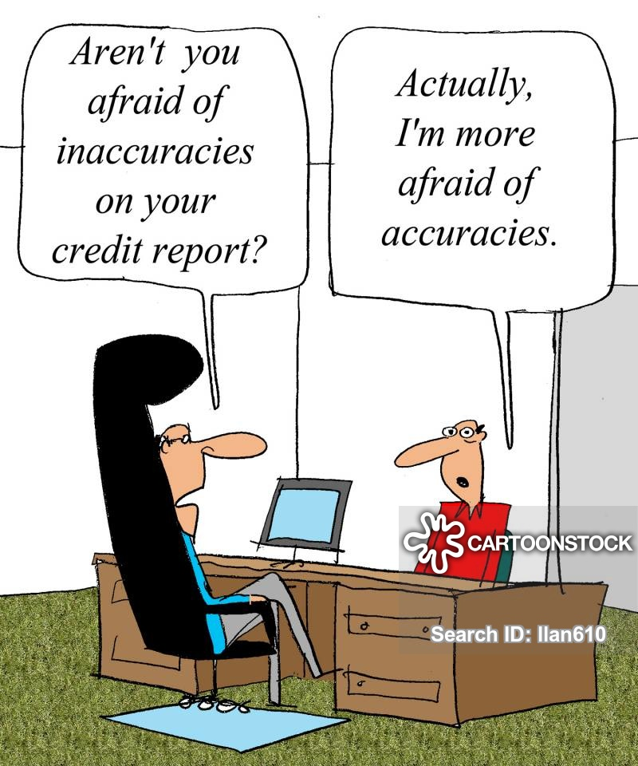
Financial instruments and their dependence on creditworthiness

Slide 30
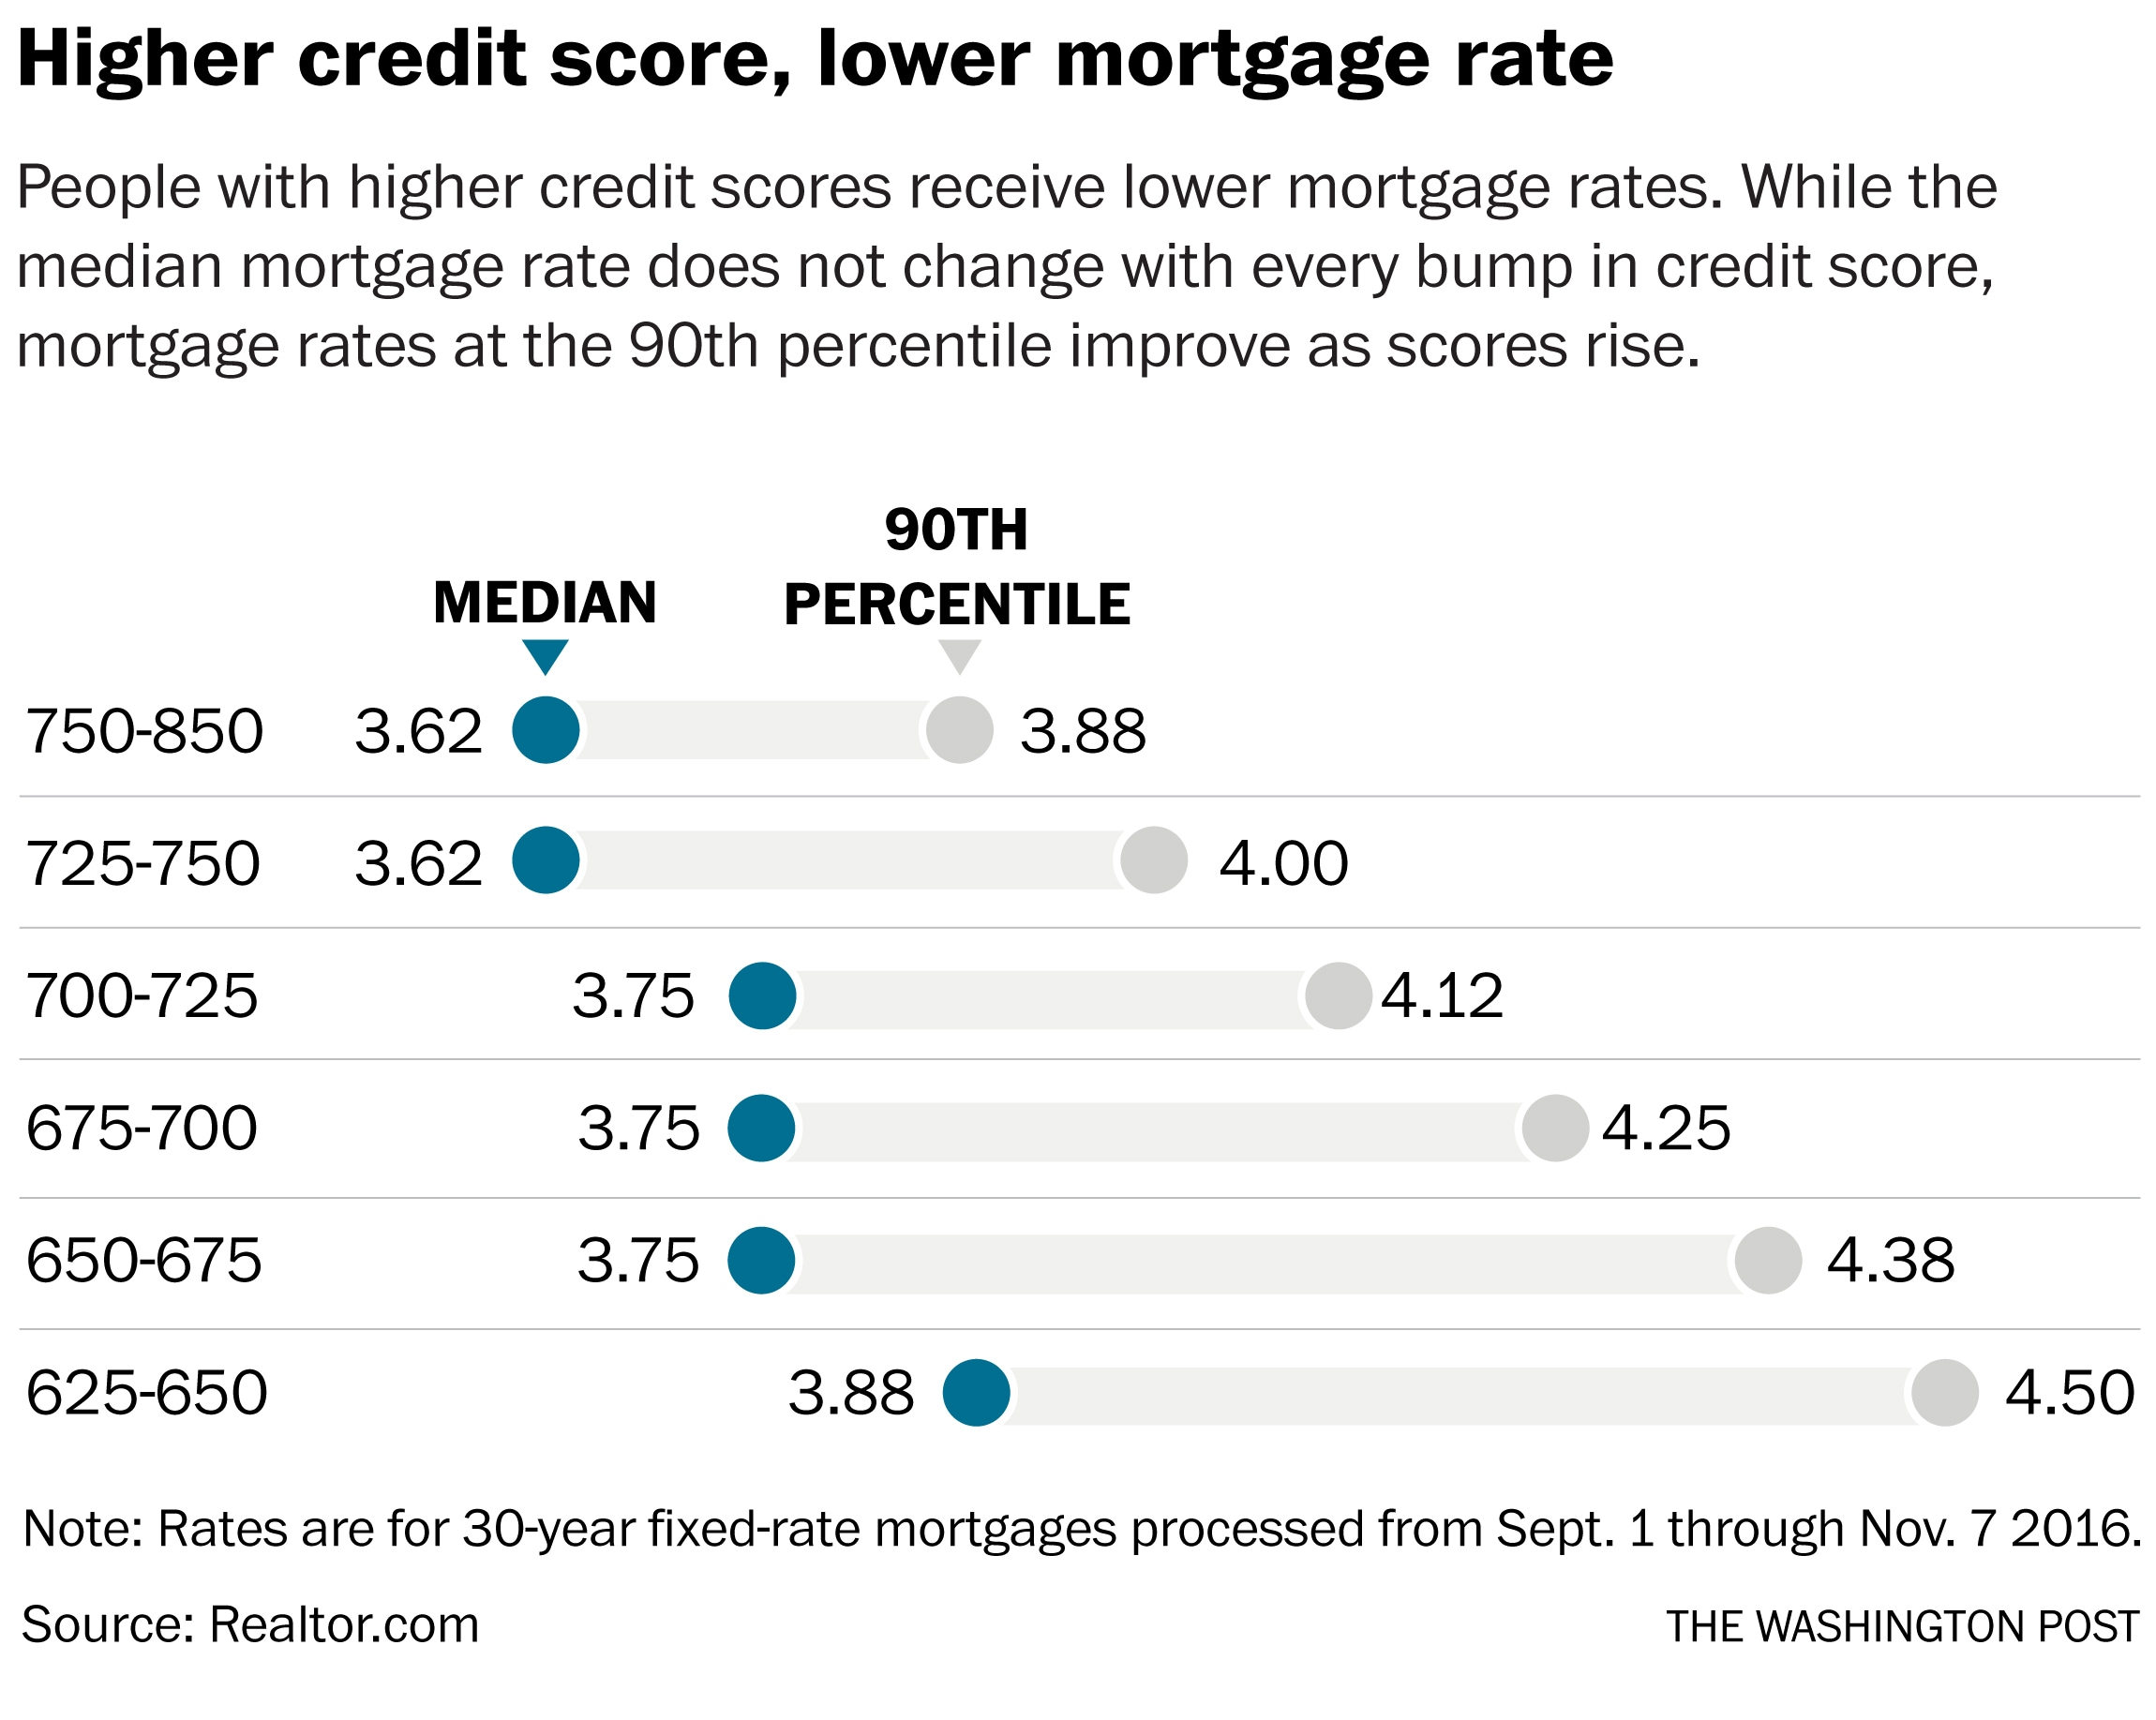
Personal Credit Scores and Mortgage Rates

Slide 31
Impact of credit ratings on access to capital
Credit ratings have the potential to affect the cost of capital, investment process, accessibility to financial markets, and in turn, the overall value of firms
Firms may take preventive moves, especially to avoid unfavourable ratings and maintain better ratings within the investment grades
From The impact of credit ratings on capital structure, December 2019, https://www.emerald.com/insight/content/doi/10.1108/IJIF-03-2018-0028/full/html

Slide 32
Impact of credit ratings on financial instruments in the water sector
Commercial banks
  Difficult to assess based on limited examples
  Up to 25% spread between investment and speculative grade borrowers
Impact investors
  Difficult to assess based on limited examples
  Water Impact Fund – preference for debt over equity on poorly-rated entities due to concerns over potential for default

Slide 33
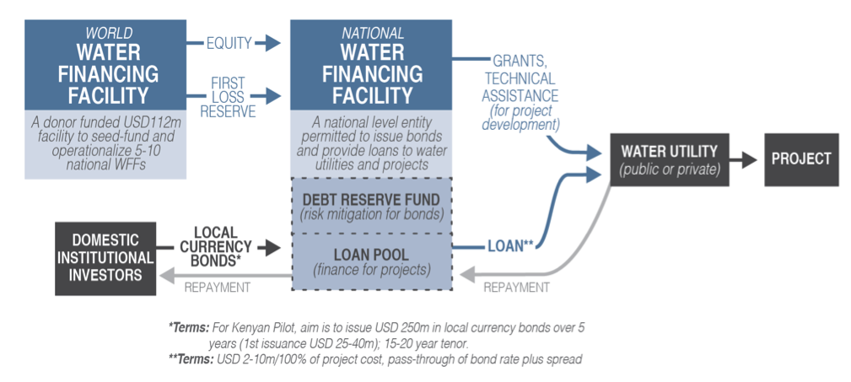
Alternative financial instruments
From https://www.climatefinancelab.org/project/water-finance/

Slide 34
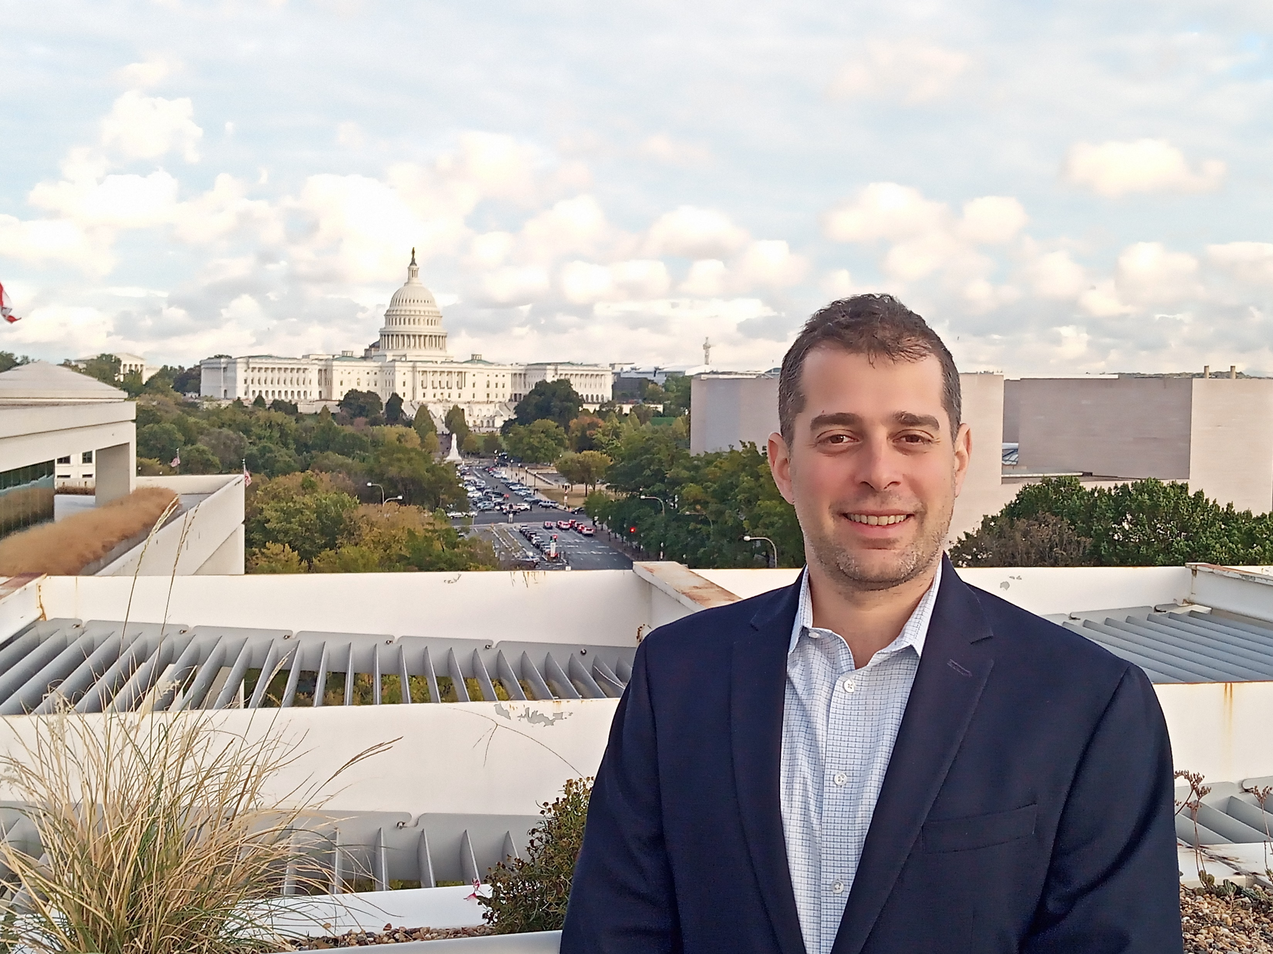
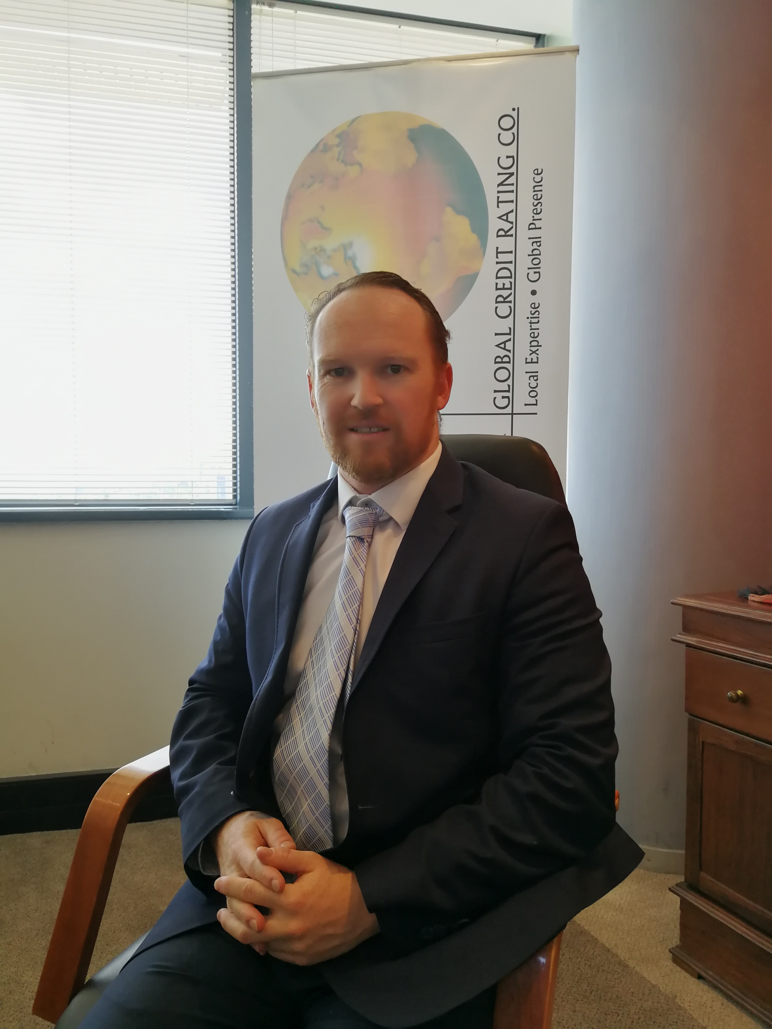
Thank you for your attention!
For more information, contact
Jeremy Gorelick
e-mail: Jeremy.Gorelick@wellersimpact.com
Eyal Shevel
e-mail: shevel@gcrratings.com
ROCKBlue
e-mail: info@rockblue.org

Slide 35

Financing Facility for Emergency Pandemic Response
Other considerations:
Amount of funds to be provided
  Equal to the reduction in cashflow caused by the pandemic?
  Equal to funds needed to keep operating?
  Equal to funds needed to cover essential expenditure?
Restrictions on use of funds
  Only essential uses? (e.g. wages and salaries, chemicals, electricity, PPE, emergency water provision)
  Broader uses? (e.g. to also include backlog maintenance, debt service, major capital projects for economic stimulus)
  None?
Linking reforms to financial support
  Disbursements contingent on action or performance milestones?
  Emergency funds now (no link to reforms), and focus on reforms later?
  No link?
Utility
Sources of Finance for the Facility
Facility
Utility
Modality of Disbursement to Utilities
  Grant
  Loan
  Guarantee
  Equity
  Combination
Fiscal revenues
Commercial loans
Loan from IMF
Loans from MDBs
Concessional finance including grants
Utility

